Slide 1

The future is “agentic”! Multiple LLMs will interact to solve subset tasks leading to a goal.

Slide 2

Realistically there is a lot of promise.
Agentic workflows take us beyond the simple question-and-answer exchanges that have defined our initial forays into AI. Instead, they involve a cyclical process where AI systems continually refine their outputs, learn from interactions, and contribute more effectively over time
The next 24months will have “agentic” workflows, not bigger models.

Slide 3
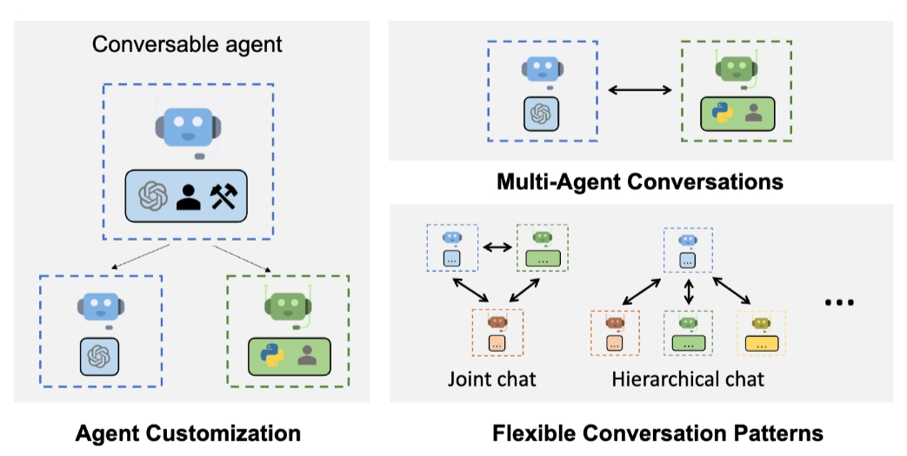
Problem solving agent workflows are emerging.
https://www.youtube.com/watch?v=sal78ACtGTc&ab_channel=SequoiaCapital

Slide 4

Open E_agenticExample.R

Slide 5

Primer on Agentic

Slide 6

Agentic Workflows can become more complicated

